Slide 1

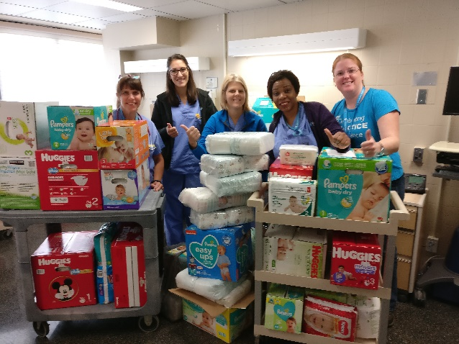

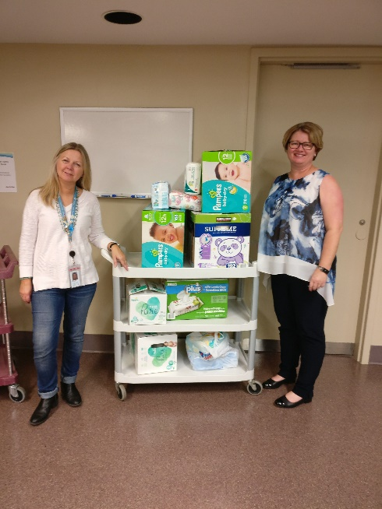
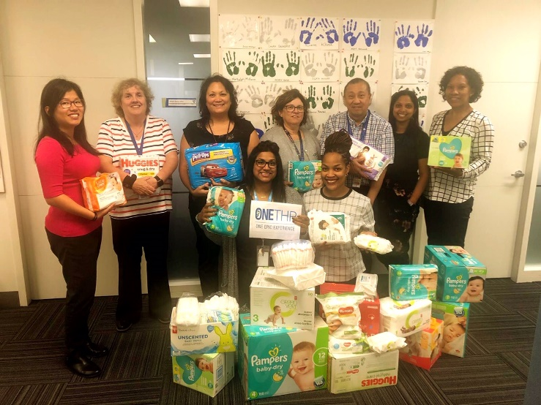
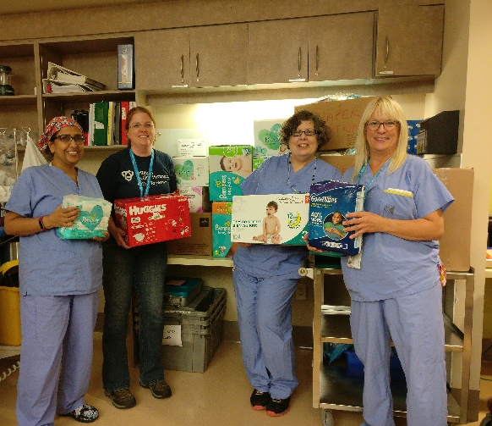
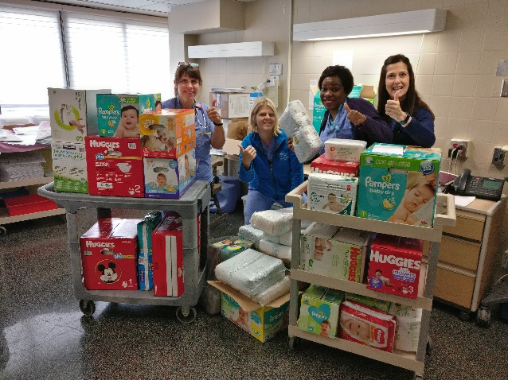
5267 DIAPERS and 8030 WIPES
THP Participated in the 3rd Annual CAPWHN Diaper Drive #CAPWHN
Thank you to everyone that donated – we were able to share the donations with 3 local foodbanks!!
Special Mention to Birthing Suites, OneTHP, POPS, the Laboratory and DI as the top 5 donors!!

